Slide 1
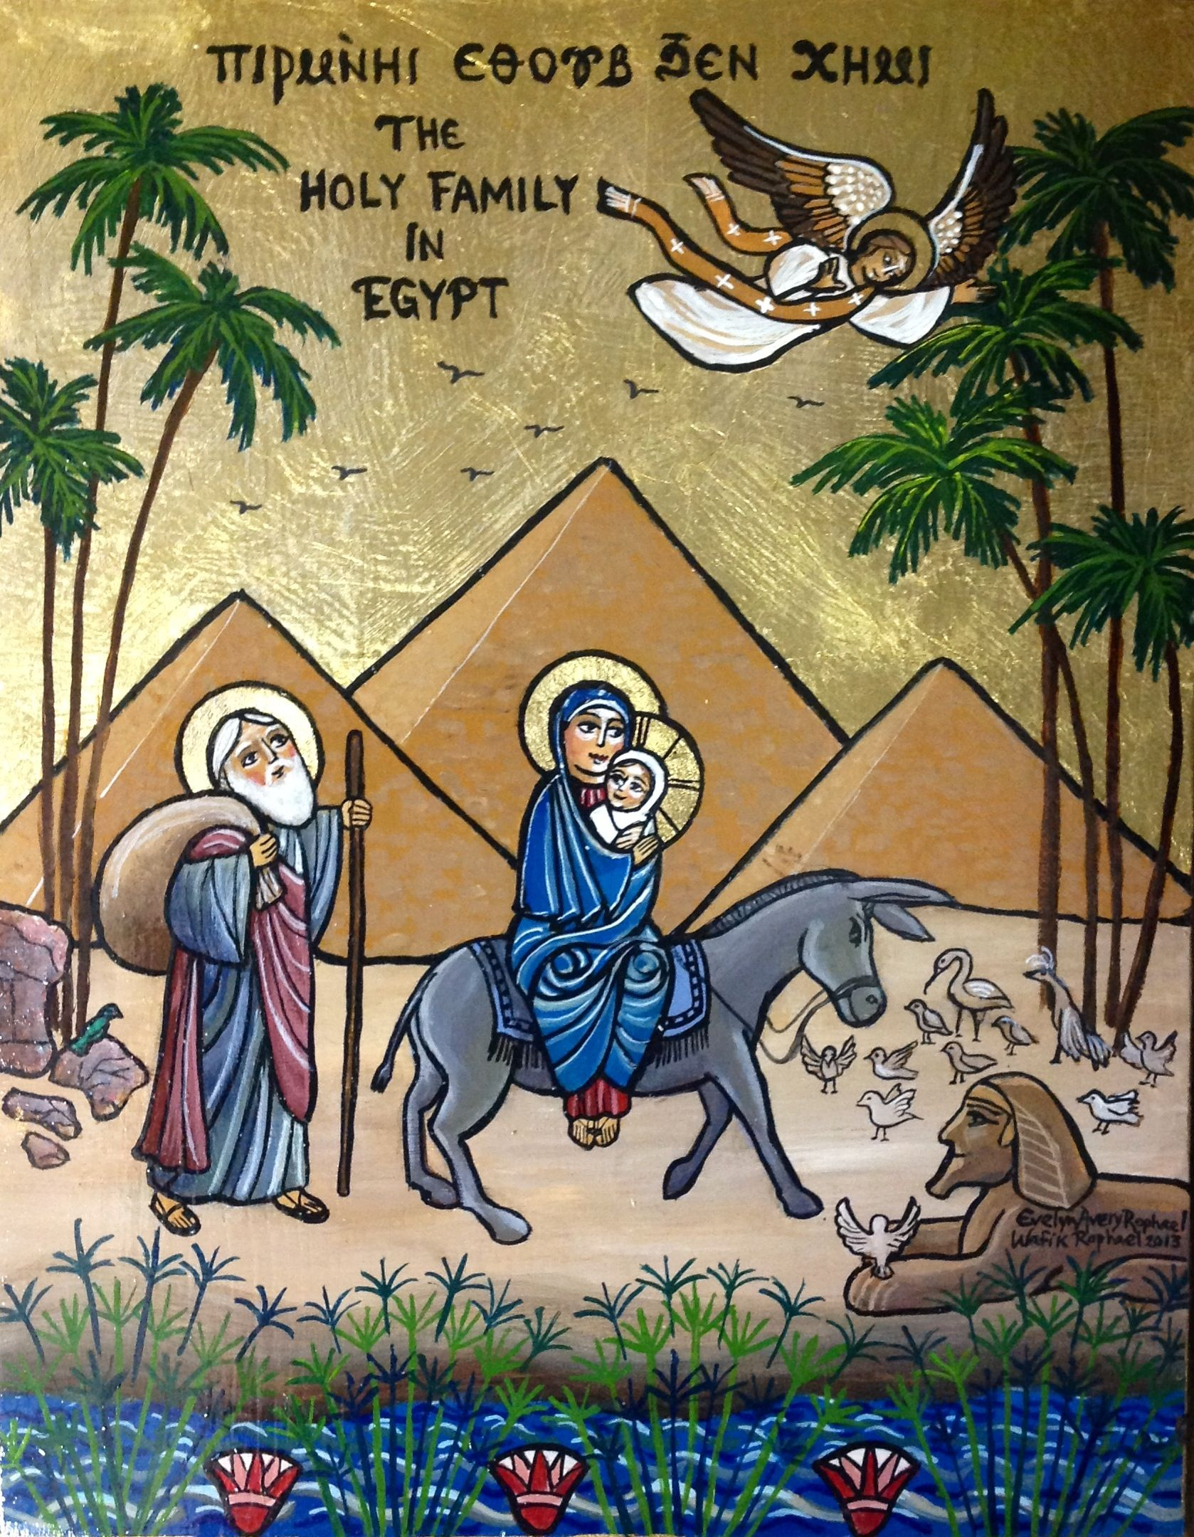
Last Tuesday (June 1st of every year) we celebrated a very special feast?
“The commemoration of the Entry of our Lord Jesus Christ to Egypt”

Slide 2
How long did the Holy Family stay in Egypt?
The journey from Bethlehem to Egypt and back to Bethlehem took around
3 years & 11 months
3500 Km = 2175 mile

Slide 3
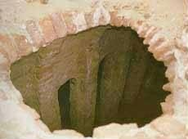
Farma (Tal Farma - Sinai)
1st main city
An old church built into a cave where the Holy Family stayed.

Slide 4
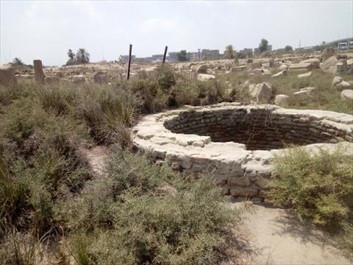
Tel Basta - Zagazig
Small town near Mustorod in Zagazig where the Lord Jesus caused a water spring to well up from the ground

Slide 5
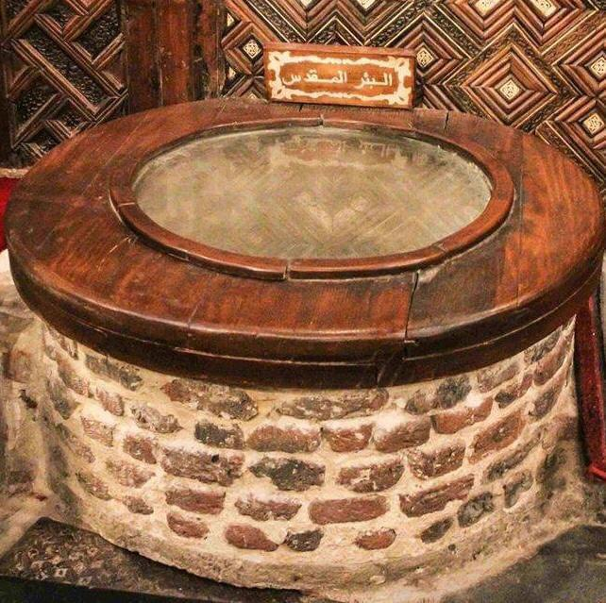
Mustorod Cairo
Another well the Holy Family drank from it and till today it is always full of water.

Slide 6
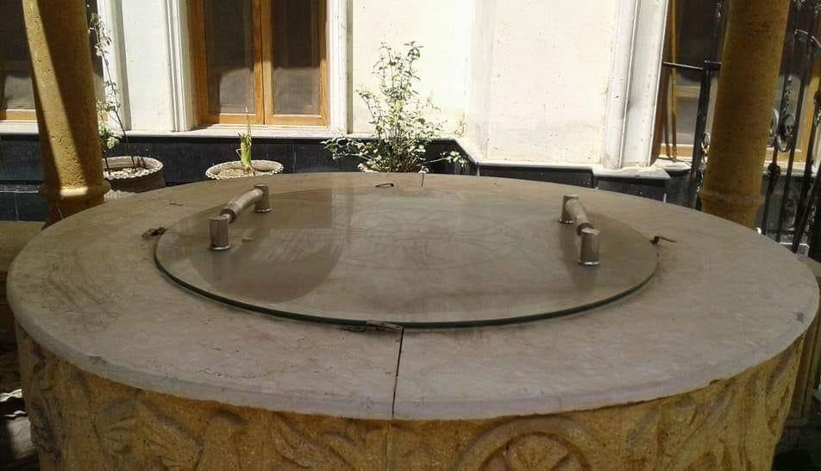
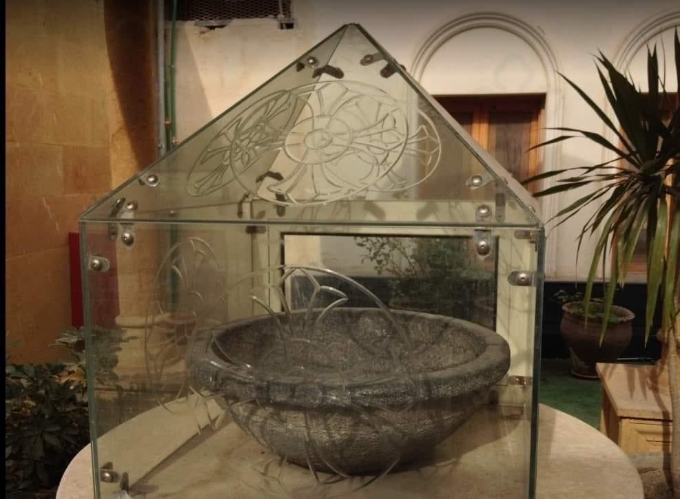
Sammanoud- Dakahleya
In St. Mary & St. Abanoub church Sammanoud there is a well where the Holy Family drank and till today the water didn’t dry.
In the same church till today a big pot St. Mary used to make bread dough.

Slide 7
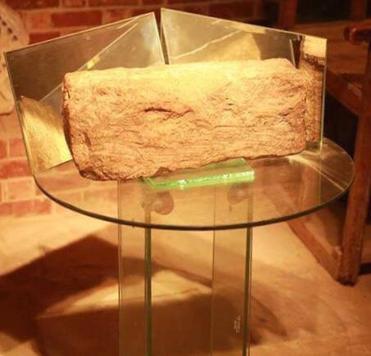
Sakha – Kafr Elsheikh
When The Holy family entered this city, Sakha people there refused to give them water, so the baby Jesus touched a rock by His foot and water came out of the rock and till today in St. Mary church in Sakha they have the rock that has the footprint of Jesus Christ.

Slide 8
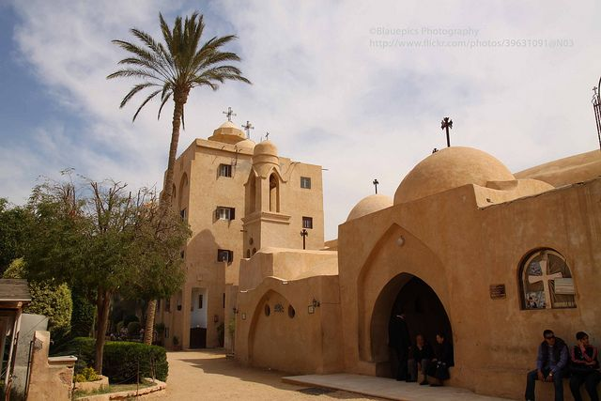
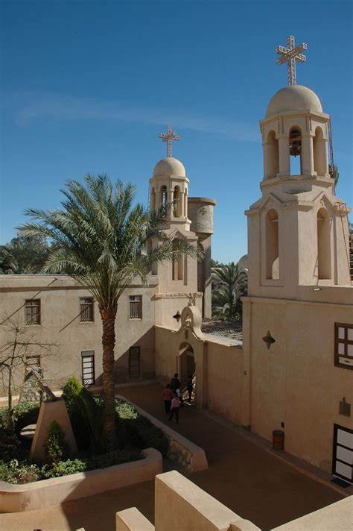
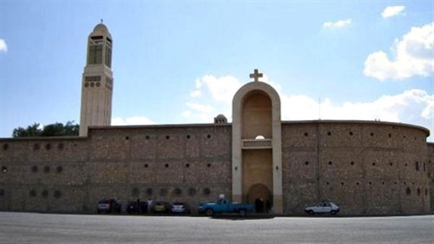
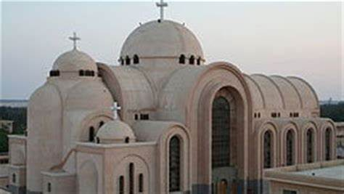
Wadi Elnatroon
St. Mary “Elsoryan”
St. Mary “Elbaramous”
St. Abo Makar
St. Bishoy
Wadi Elnatroon ancient monasteries are located there

Slide 9
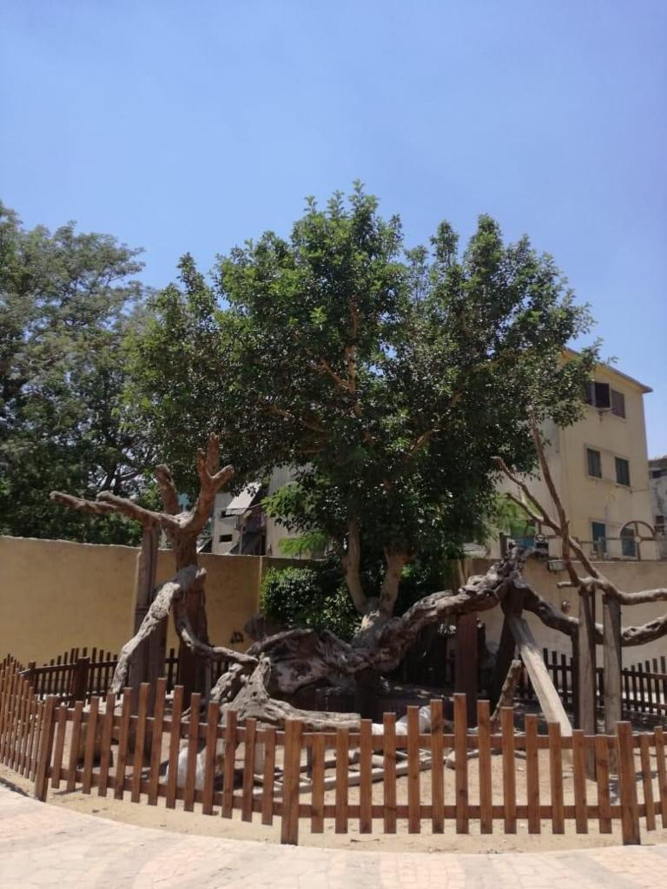
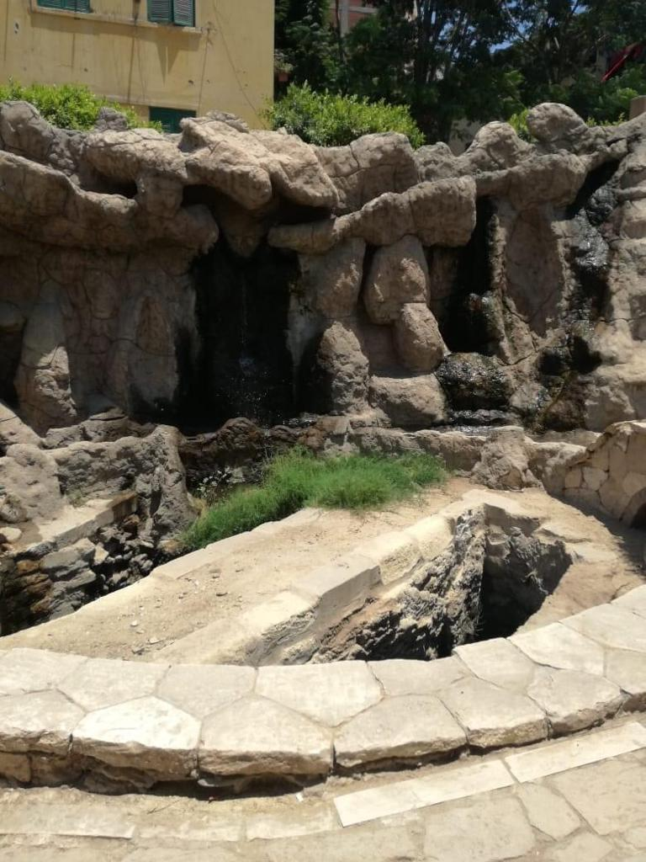
The story of the 2 streets
Ain Shams/Mataria
St. Mary‘s tree
A big sycamore tree the Holy family used as shade and till today this tree is growing.
Another well baby Jesus made so the family can drink and till today the well is always full.

Slide 10
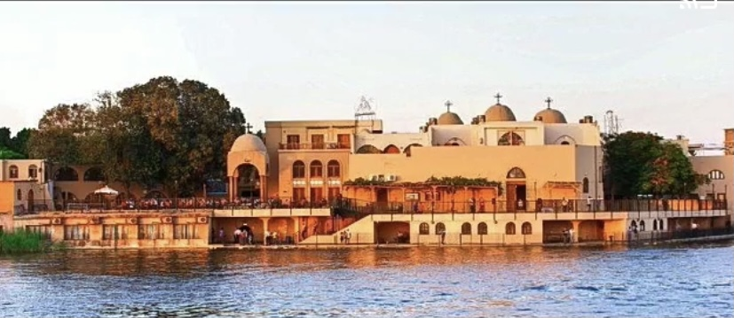
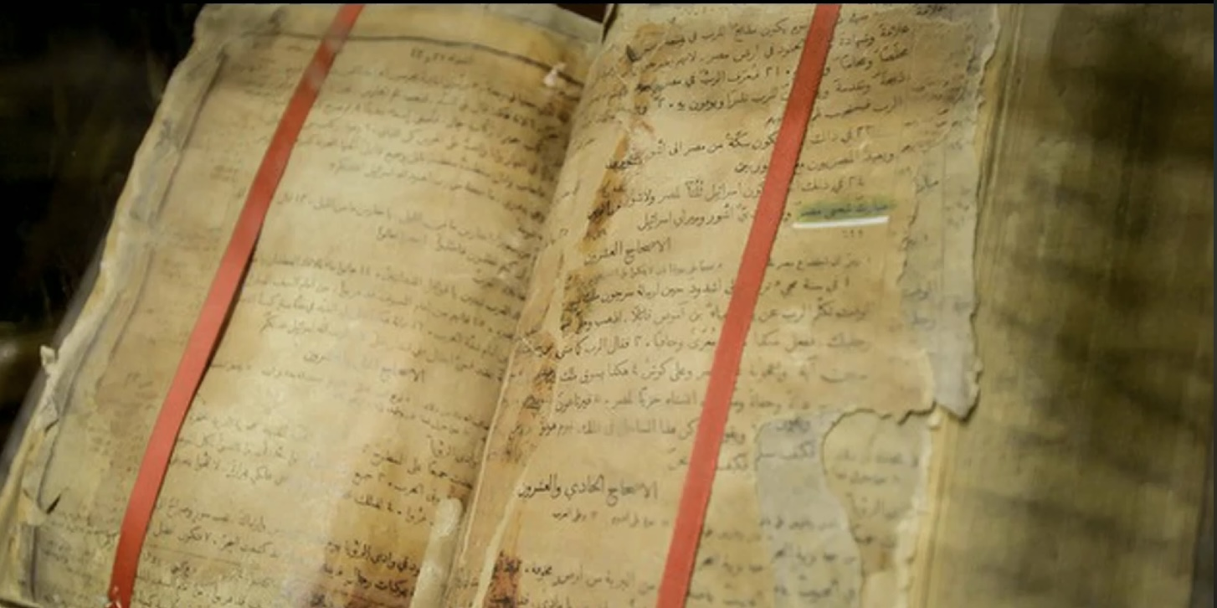
Maadi – Cairo
St. Mary‘s church
Maadi is the place where the Holy Family crossed the Nile river to go to upper Egypt
March 12, 1976, they found Bible floating on the water in front of the church showing
“Blessed is Egypt My people.” (Isaiah 19:25)

Slide 11
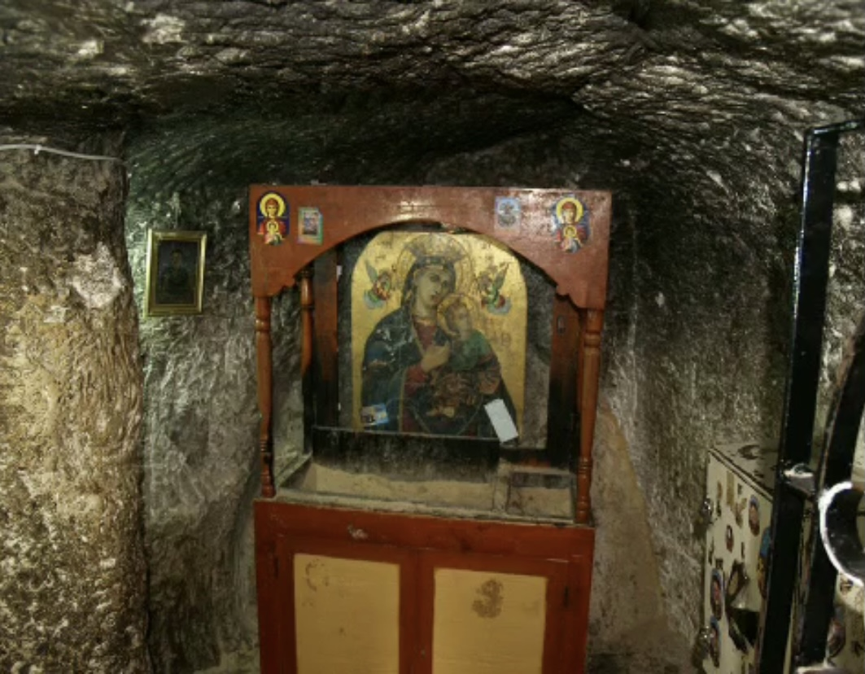
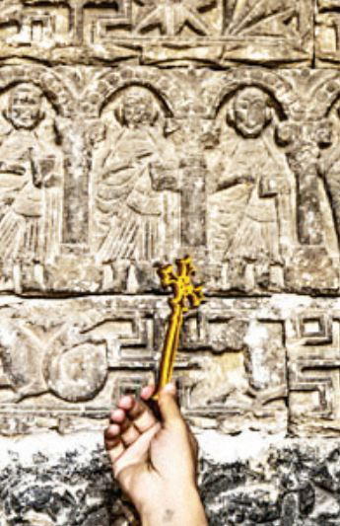
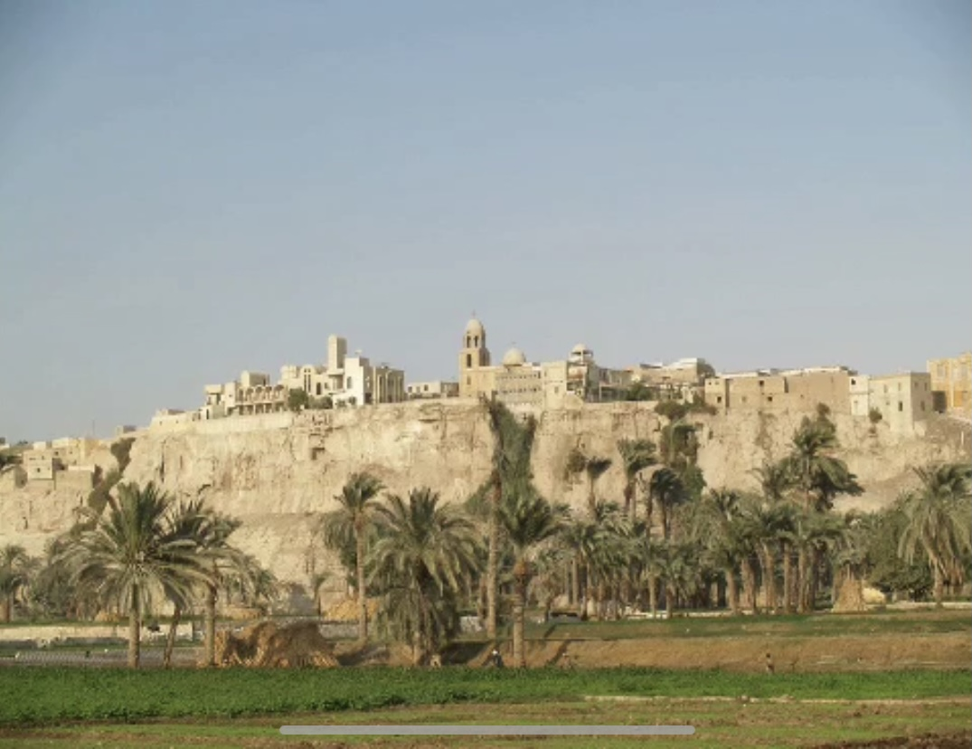
Gabal Eltair – Minia
“Mountain of birds”
St. Mary‘s monastery
On the top of the mountain
On their way to the top of the mountain baby Jesus touched a big rock with His hand to save the Holy Family. The imprint of His hand is still there.

Slide 12
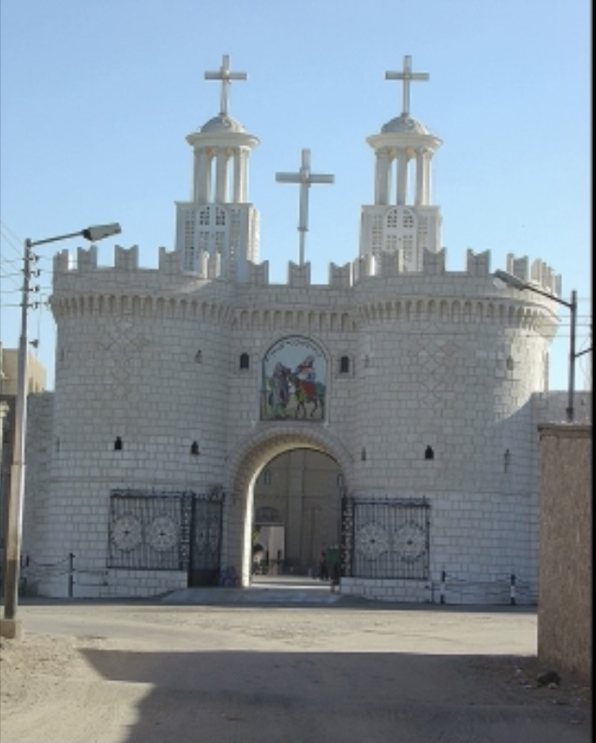
St. Mary‘s monastery
Built near to the mountain of Qussqam in the place of a cave where the Holy Family stayed 6 months
Gabal Qussqam – Assiut
Elmoharaq
“Last Stop”

Slide 13
Belbeas
The Holy Family sat under a Sycamore tree to rest which was later known as the Virgin Mary tree.
Bahnassa
Later named Abay isos “house of Jesus”
12. Smalot-They crossed the Nile

Slide 14
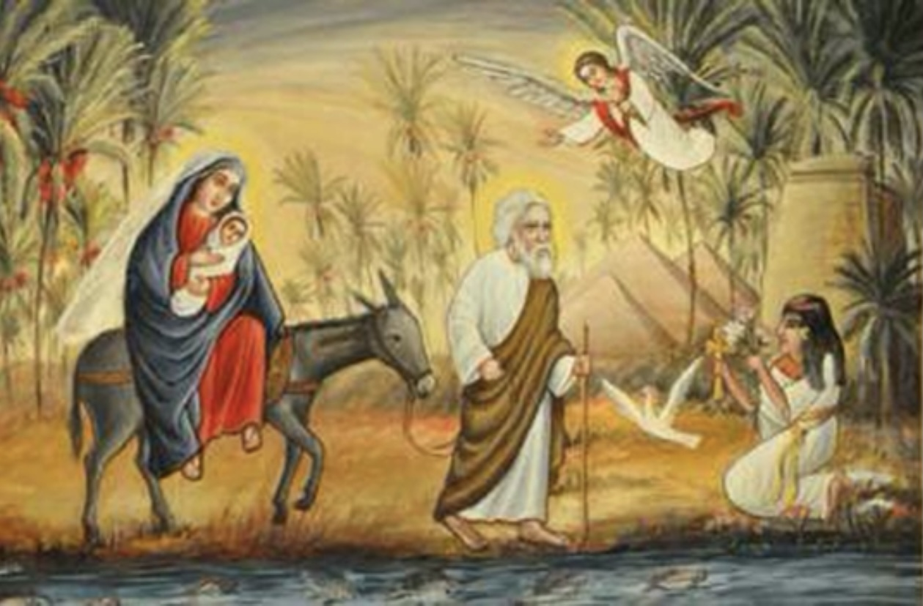
Here; The Angel of The Lord appeared to St. Joseph and told him to go back to Jerusalem.
““Arise, take the young Child and His mother, and go to the land of Israel, for those who sought the young Child’s life are dead.” (Matthew 2:20)

Slide 15
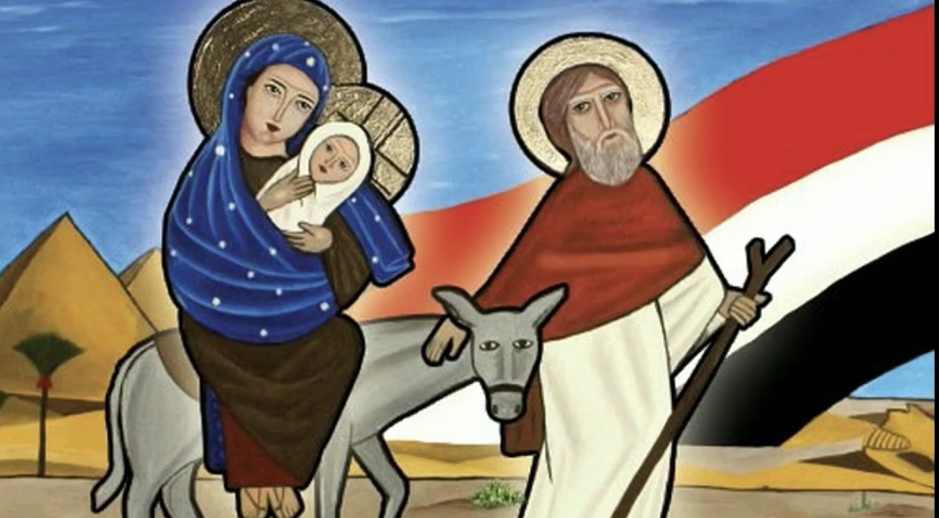
“Out of Egypt I called My Son.” (Hosea 11:1)

