Slide 1
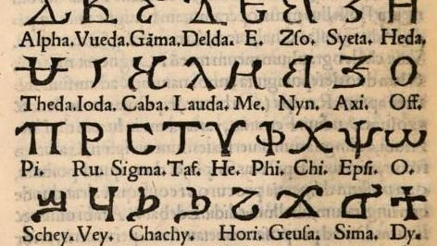
History of the Coptic Language Development

Slide 2
The Coptic language was developed in Egypt around the 2nd or 3rd century CE and historically spoken by the Copts as the final stage of the ancient Egyptian language and was mainly used by Christians in the Byzantine Period and under Islamic rule

Slide 3
What are the stages of development for the Ancient Egyptian language?

Slide 4
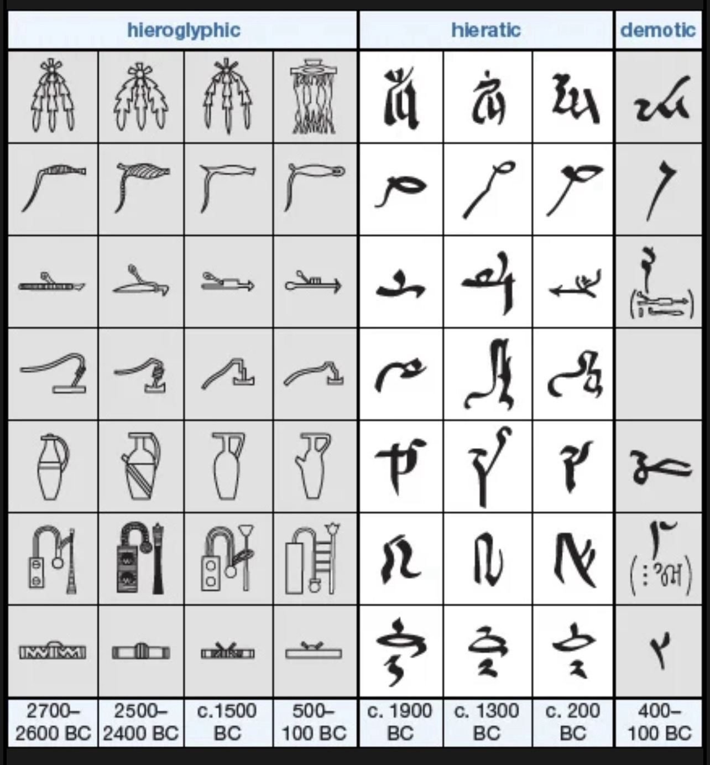

Slide 5
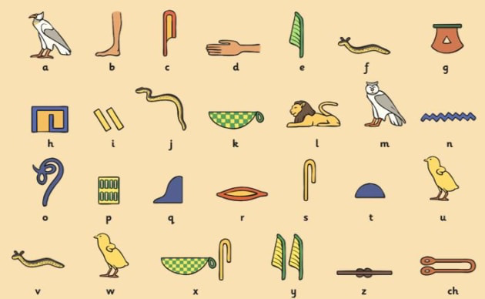
1- Hieroglyphic writing:
Is the system that employs characters in the form of pictures. Those individual signs, called hieroglyphs, may be read either as pictures, as symbols for objects, or as symbols for sounds.
￼

Slide 6
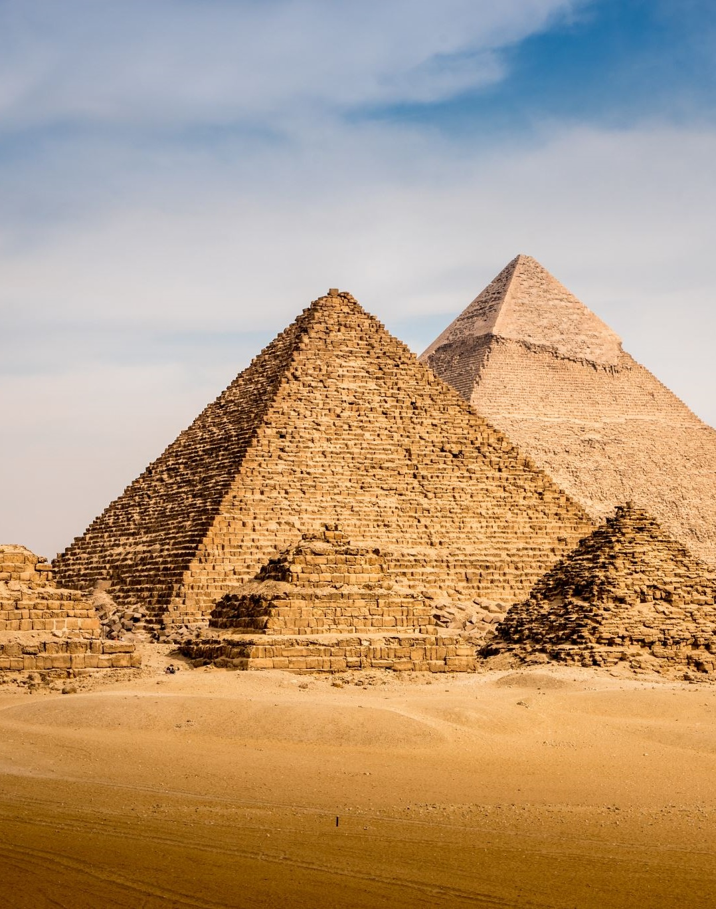
2- Hieratic Script:
Is the ancient Egyptian cursive writing, used from the 1st dynasty (c. 2925–c. 2775 BCE) until about 200 BCE. Derived from the earlier, pictorial hieroglyphic writing used in carved or painted inscriptions

Slide 7
3- Demotic Script:
Egyptian hieroglyphic writingof cursive form that was used in handwritten texts from the early 7th century BCE until the 5th century CE. Demotic script derived from the earlier pictographic hieroglyphic inscriptions and the cursive hieratic script, and it began to replace hieratic writing during the reign of Psamtik

Slide 8
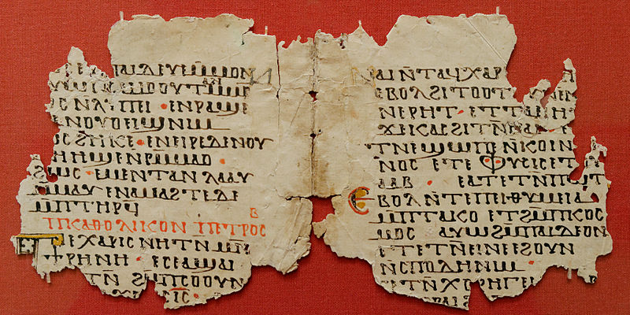
4- The Coptic language,
As the final stage of the Egyptian language:
* In contrast to earlier stages of Egyptian, which used hieroglyphic writing, hieratic script, or demotic script, Coptic was written in the Greek alphabet, supplemented by seven letters borrowed from demotic writing. Coptic also replaced the religious terms and expressions of earlier Egyptian with words borrowed from Greek.

Slide 9
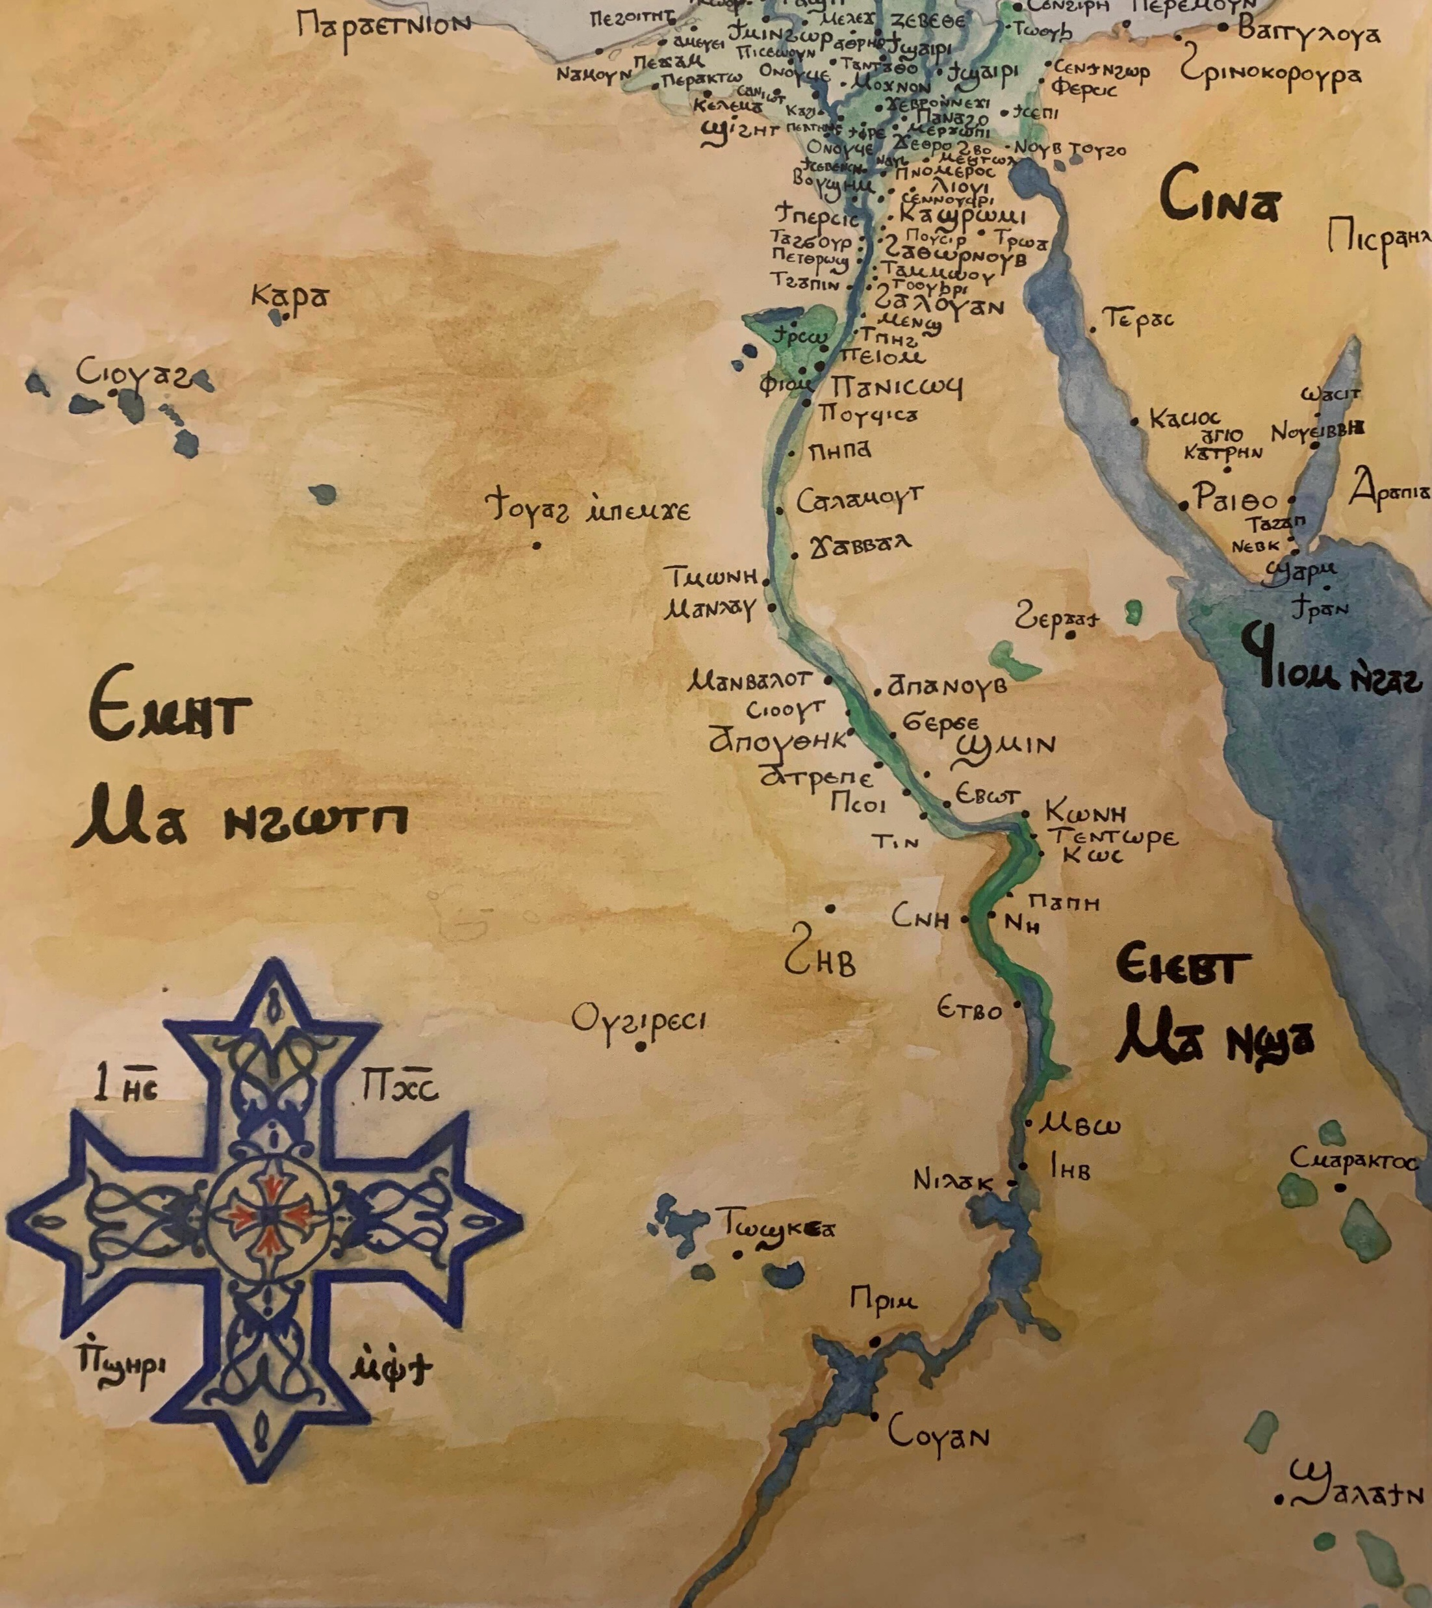
Coptic is usually divided by scholars into six dialects, four of which were spoken in Upper Egypt and two in Lower Egypt; these differ from one another chiefly in their sound systems. The Fayyūmic dialect of Upper Egypt, spoken along the Nile River valley chiefly on the west bank, survived until the 8th century.

Slide 10
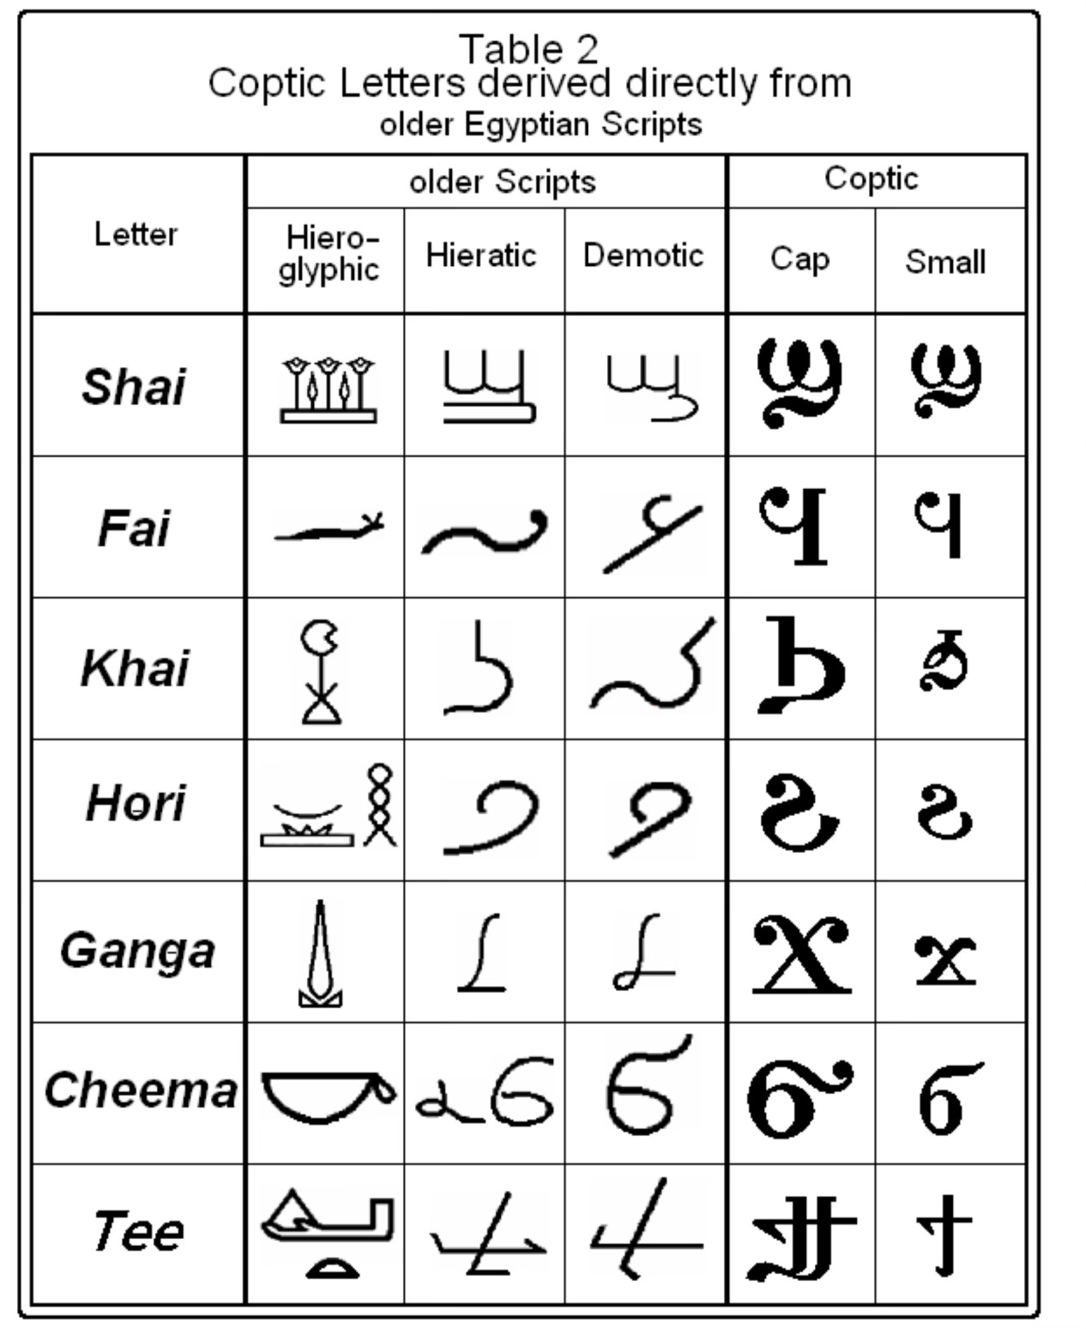
The Coptic language is not a new language spoken by the Egyptians on the advent of Christianity. It is the final stage of the uninterrupted ancient Egyptian language.

Slide 11
