Slide 1
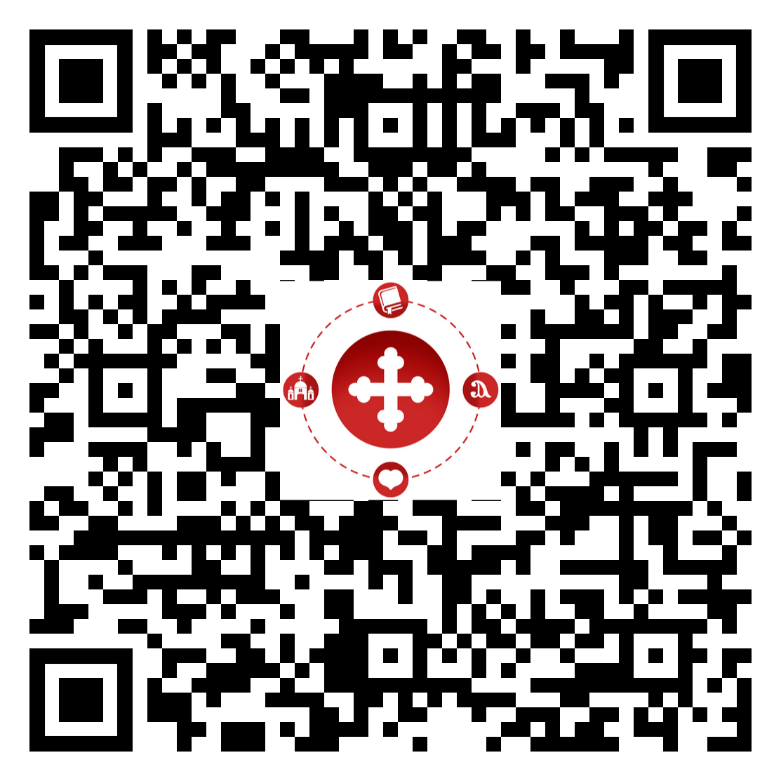
The church vessels - 2

Slide 2
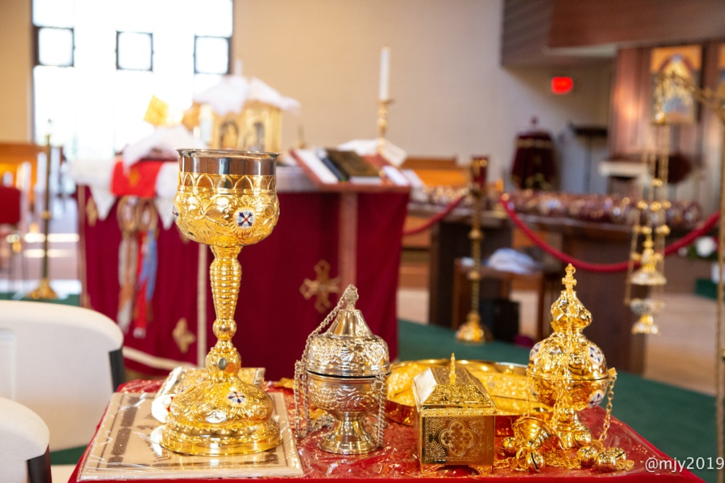
Service Vessels
The service vessels are used in the Divine Liturgy they are sanctified for the services by the Bishop or the Pope’s prayers (1Timothy 4:5) and the Holy Myroon. The church recognized the need to sanctify them as the Lord ordered Moses to sanctify the Tabernacle, the Ark of the Covenant, the Table, the Sacrifice Altar, the Vessels, and all Priests’ clothes to be holy for the ritual services and everyone who touched them became holy and sanctified for the services (Exodus 30:29 & Leviticus 8:30).

Slide 3
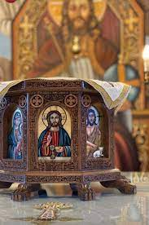
The Throne (Ark)
A wooden square box, where the chalice sits, on top of the Altar
It is called the Throne because the Blood of Christ "sits" in it
It is called the Ark because the Blood with gives life to who ever drinks from it, is represented by the pot of Manna which was in the Ark of covenant and was a symbol of the true Body of Christ
It is also known as the tabernacle because it looks like the tabernacle of the Old
Testament which contained portions of the manna.

Slide 4
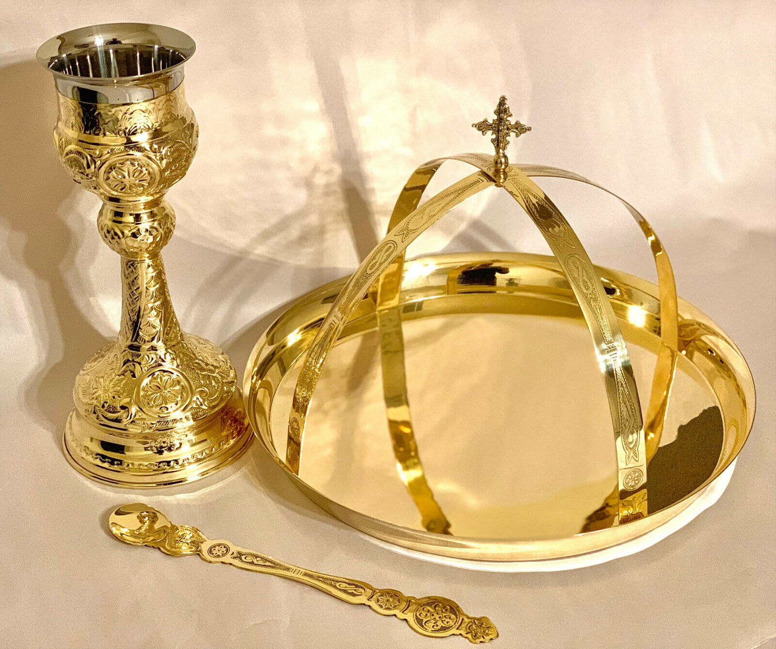
Paten (orban plate) and Chalice:
Ιn which the orban and wine are placed during the mysterious service of the Divine Liturgy and they are converted by the power of the Holy Spirit into the True Body and the True Blood of the Lord Jesus Christ. The Lord Jesus Christ in the Last Supper used a paten and chalice (Matthew 26:26&27) and following Him the Apostles did the same (1 Corinthians 10:16)
The paten, is also used by the church to protect against losing any particles from the Body of Christ
The Body of Christ is placed in it so it represents: The womb of St. Mary; The Manger and The tomb
The Chalice
The Communion Cup, into which wine mixed with water is poured, is consecrated into the Blood of the Lord through the Liturgy of Eucharist. The Lord Himself used the chalice (Mt. 26:26, 27) and the Apostles imitated Him. St. Paul the Apostle calls it “the Cup of Blessing” and “the Cup of the Lord”. (1Cor. 10:16,21). Tertullian refers to it as having the shape of a lamb engraved outside of it, to remind us of the Lamb of God Who purchased His Church and adorned her entirely with His Holy Blood.

Slide 5
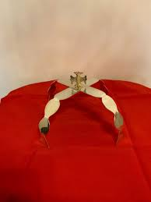
The Dome (Star)
Made of two arches that cross together and form the shape of a cross
This dome is put on the paten representing the Lord's grave or manger.
On top of it is a cross referring to the sheltering cherubim, or the star on top of Jesus's manger.
Represents the star that appeared to the wise men and stopped above the house where Jesus lay

Slide 6
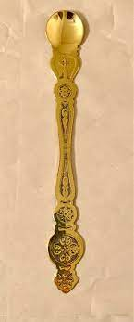
The Spoon (Mysteer)
To administer the Blood to the believers

Slide 7
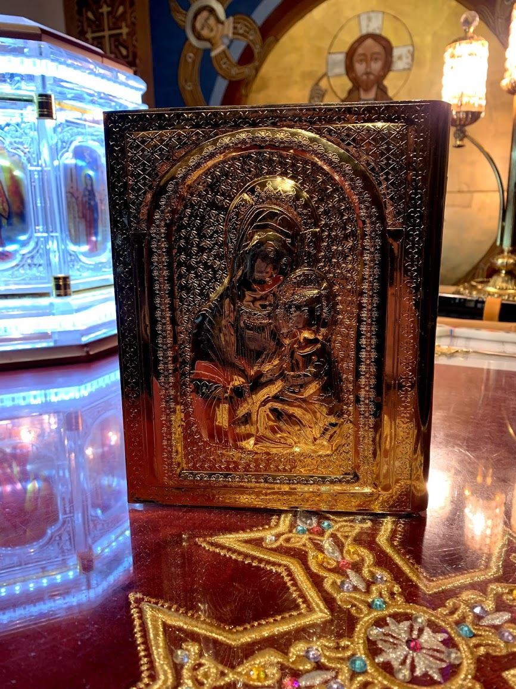
The Gospel
A metal case, wherein a copy of the 4 gospels are placed.
An icon of St. Mary is usually on one side, and an icon of Cross on the other

