Slide 1
The church’s Shapes

Slide 2
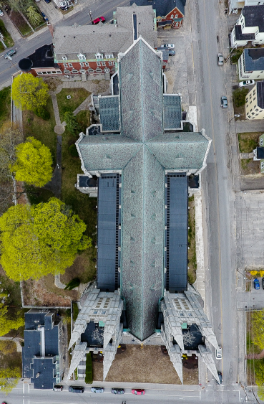
The Cruciform Shape:
This type gives an idea of the mystical nature of the Church, as being the crucified Body of Christ.

Slide 3
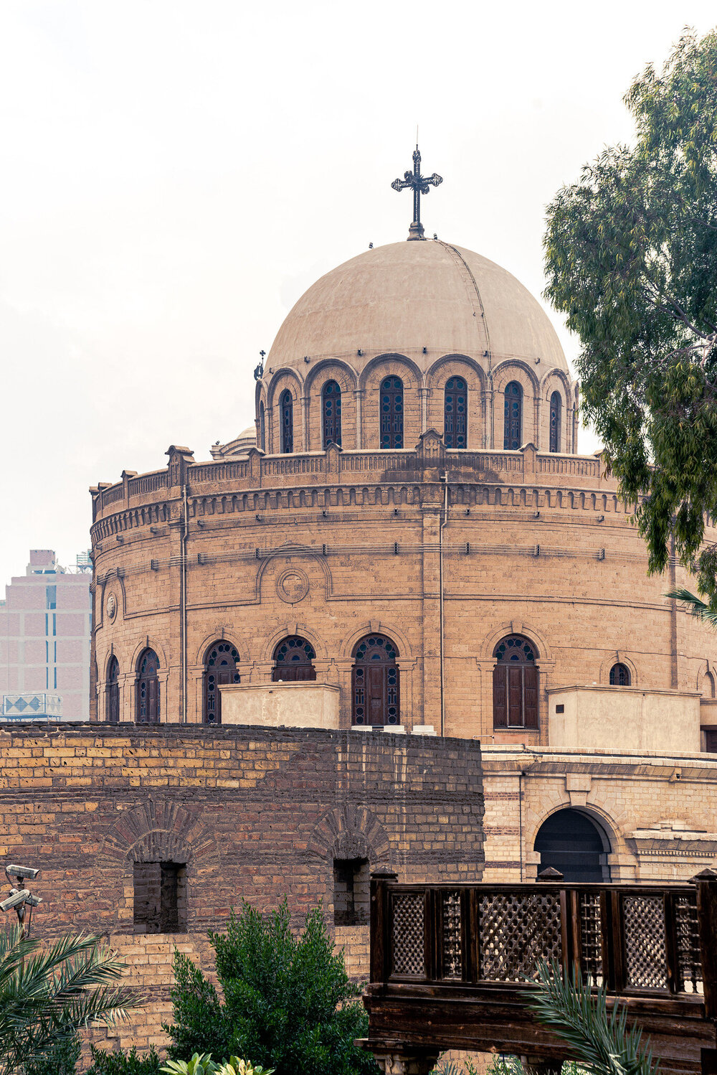
The Circular Shape:
This design refers to the eternal nature of the Church as being an endless line. This type is very common in the Coptic architecture.

Slide 4
The Shape of a Ship:
This is the most commonly used shape in the Coptic Orthodox Church. This is symbolic of Noah’s ark as those in Noah’s ark were saved from the flood, likewise the Church of God alone has the ability to save men. This describes the church in the form of a ship.

